Slide 1


Capstone Project
PGP-DSE FEB – 2019
Group IV
Group members:
Dedeepya
Ghouse
Rakesh
Shiva
Research Supervisor:
Anjana Agarwal

Slide 2

Predicting Online purchase intention

Slide 3
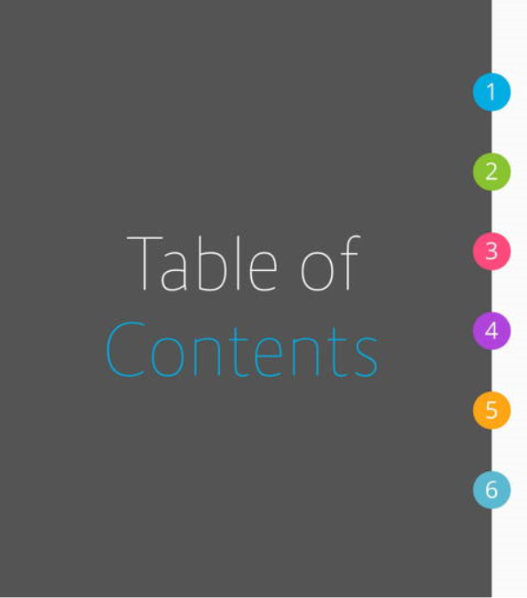
Introduction
Problem Statement
EDA using Tableau
Modelling & Evaluation metrics
Challenges
Suggestions and Conclusion

Slide 4

Introduction
Online shopping is the easy solution for busy life in today’s world.
In the past decade, there had been a massive change in the way of customer’s shopping.
Despite consumers’ continuation to buy from a physical store, the users or buyers feel very convenient
online shopping. Online shopping saves crucial time for modern people because they get so busy that they cannot or unwilling to spend much time shopping.

Slide 5

People often spend a lot of time browsing through online shopping websites, but the conversion rate into purchases is low.
Determine the likelihood of purchase based on the given features in the dataset.
The dataset consists of feature vectors belonging to online sessions.
The purpose of this project is to identify user behaviour patterns to effectively understand features that influence the sales.

Slide 6


To identify the online customers purchase
intention based on level of shopping
experience.
To identify the important predictors among
the mentioned factors to forecast the
purchase intention

Slide 7

The dataset consists of feature vectors belonging to 12,330 sessions.
The dataset was formed so that each session would belong to a different user in a 1-year period to avoid any tendency to a specific campaign, special day, user profile, or period.
The dataset consists of 10 numerical and 8 categorical attributes.

Slide 8
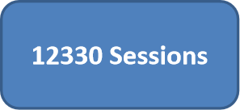
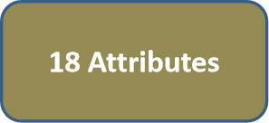
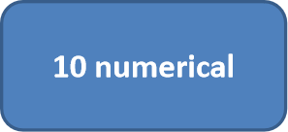
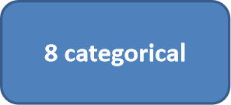

Slide 9
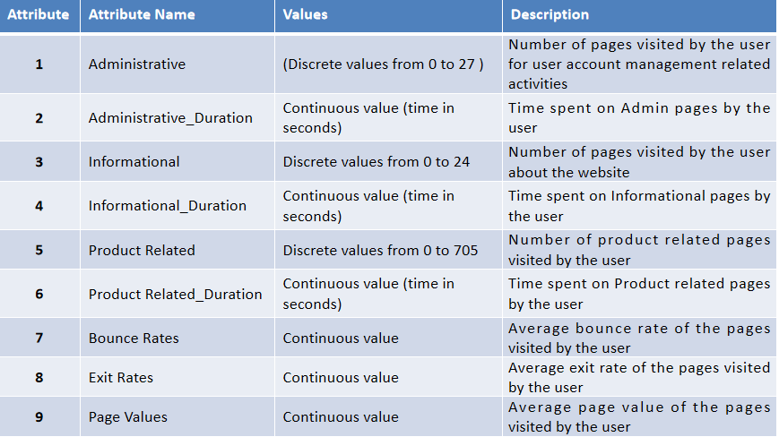

Slide 10
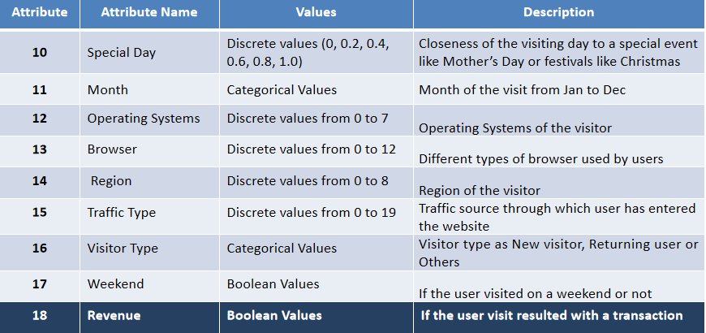
Revenue
Target Variable

Slide 11
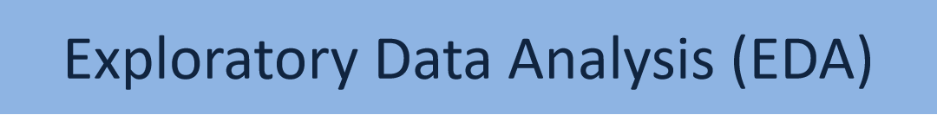
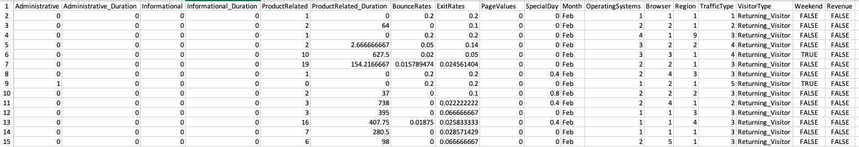
This is the Sample look of the online customer intention dataset

Slide 12
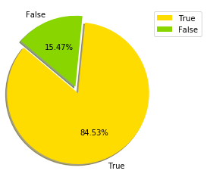
Shape of the Dataset is (12330, 18)
Rows: 12330
Columns:18
Target Variable is: Revenue(categorical variable)
which contains TRUE and FALSE values
False 84.5%
True 15.4% Name: Revenue, dtype: float64

Slide 13
Exploratory Data Analysis EDA:
This is the Sample look of the online customer intention dataset
Shape of the Dataset is (12330, 18)
Rows: 12330
Columns:18
Target Variable is: Revenue(categorical variable) which contains TRUE and FALSE values
False 84.5%
True 15.4% Name: Revenue, dtype: float64

Slide 14

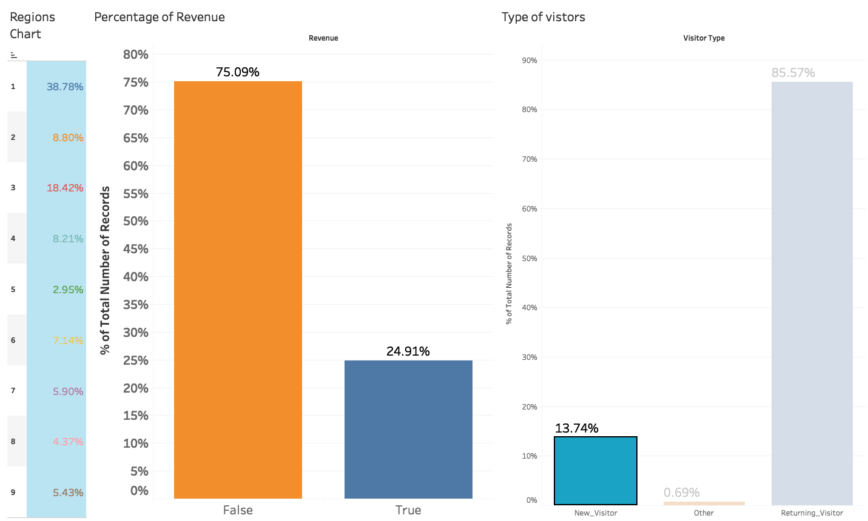
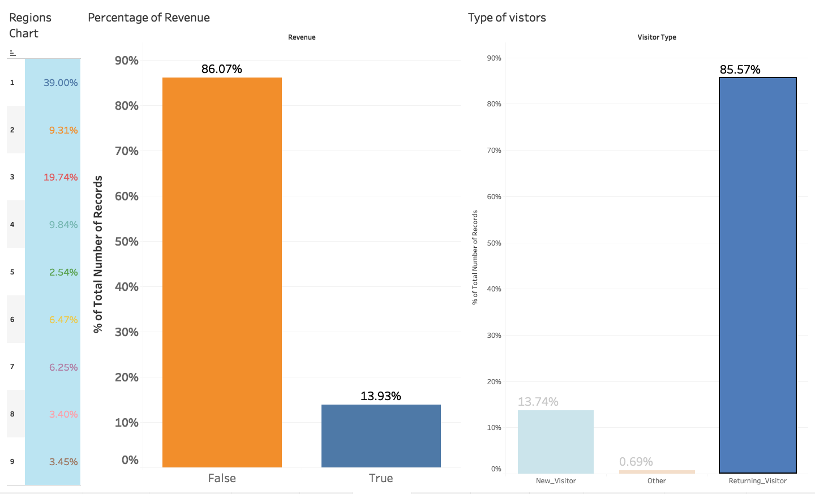
Revenue Based analysis:
New Visitors
Returning Visitors
Observation: New visitors Revenue conversion rate is high than the
returning Visitors and Others.

Slide 15
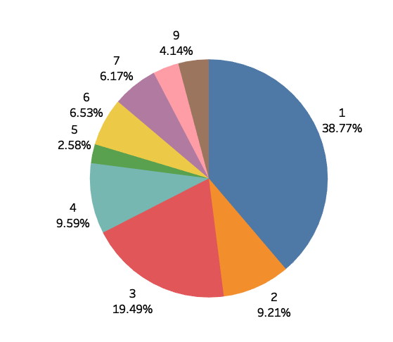
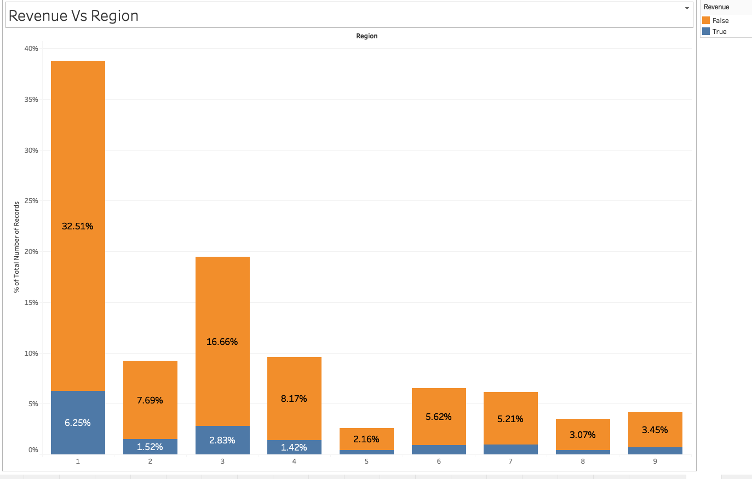
Percentage of Revenue Region records :
Percentage of Revenue Generating and not generating in Region.
Less customers are from Region 5
Most of the Customers are from Region “1”..... I.e. 38.77% and Only 6.25% of the customers are Generating Revenue.

Slide 16
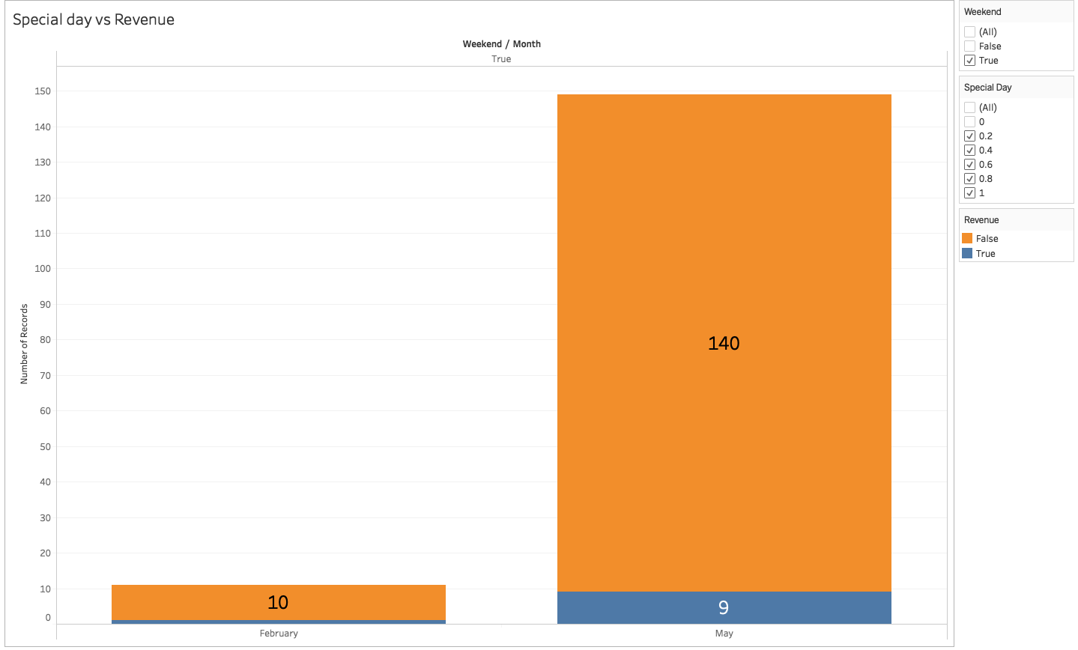
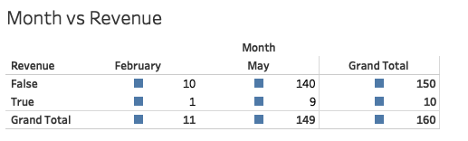
Weekend-Special day Count
There are 160 days which are special days and weekends and conversion rate count of customer to generate revenue is 9.

Slide 17
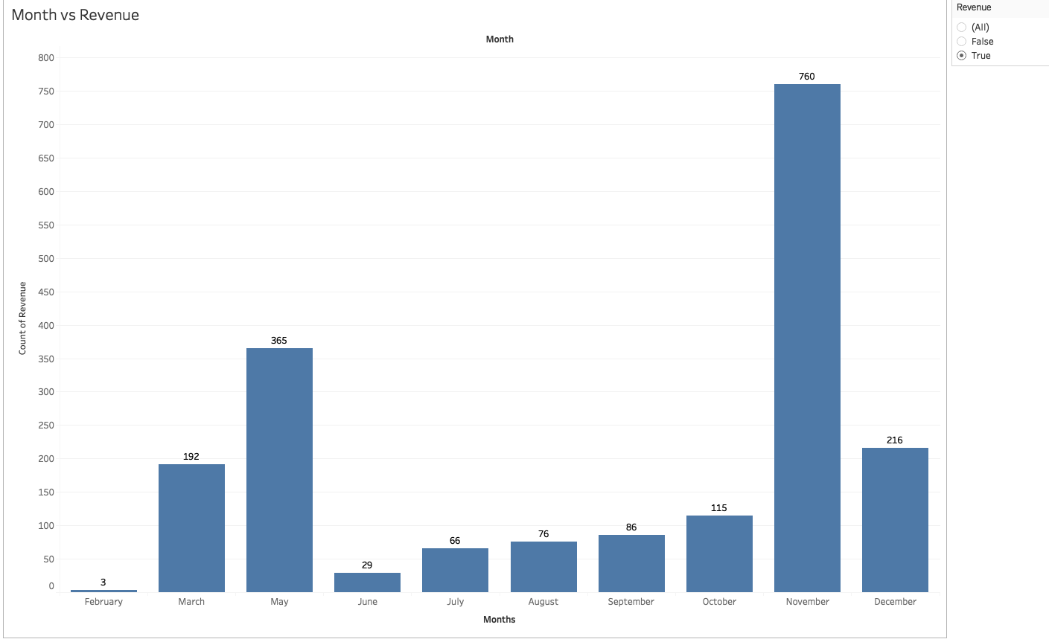
Insight :
Revenue Generating Visits:
Max in May
Min in July

Slide 18
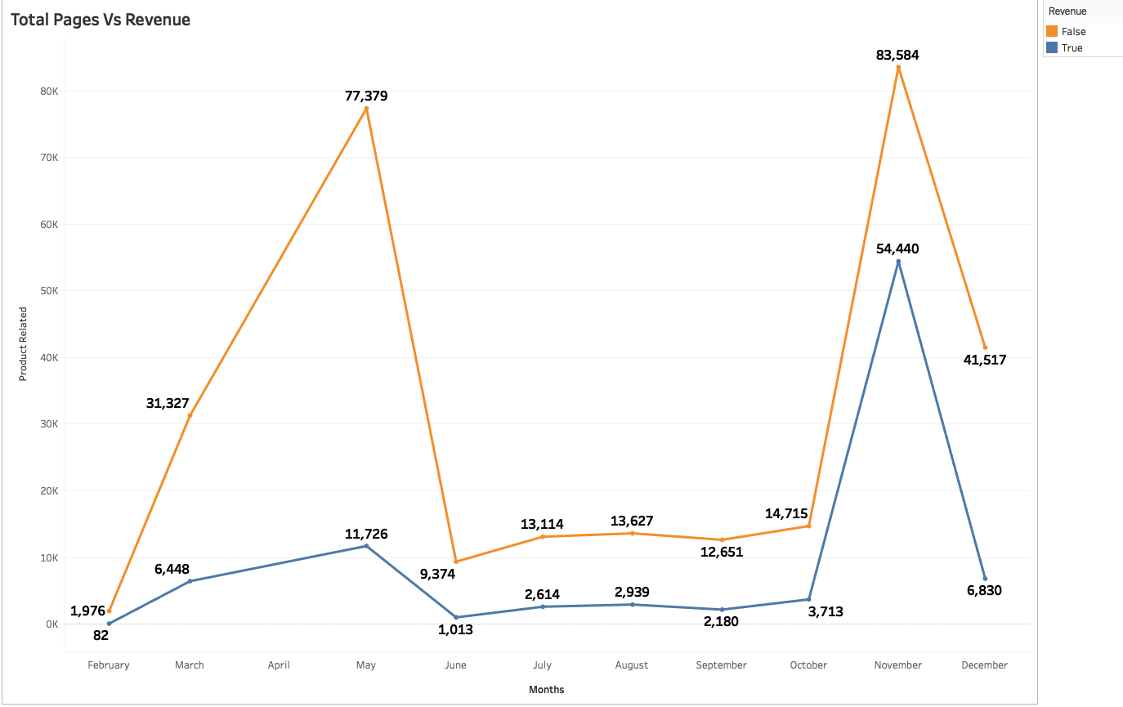
Max no of Product related pages are visited in the month May and Nov.
Conversion to Revenue is more in the month Nov when compared to May.

Slide 19
Insight :
Revenue Generating Visits:
Max in May
Min in July
Max no of Product related pages are visited in the month May and Nov.
Conversion to Revenue is more in the month Nov when compared to May.

Slide 20

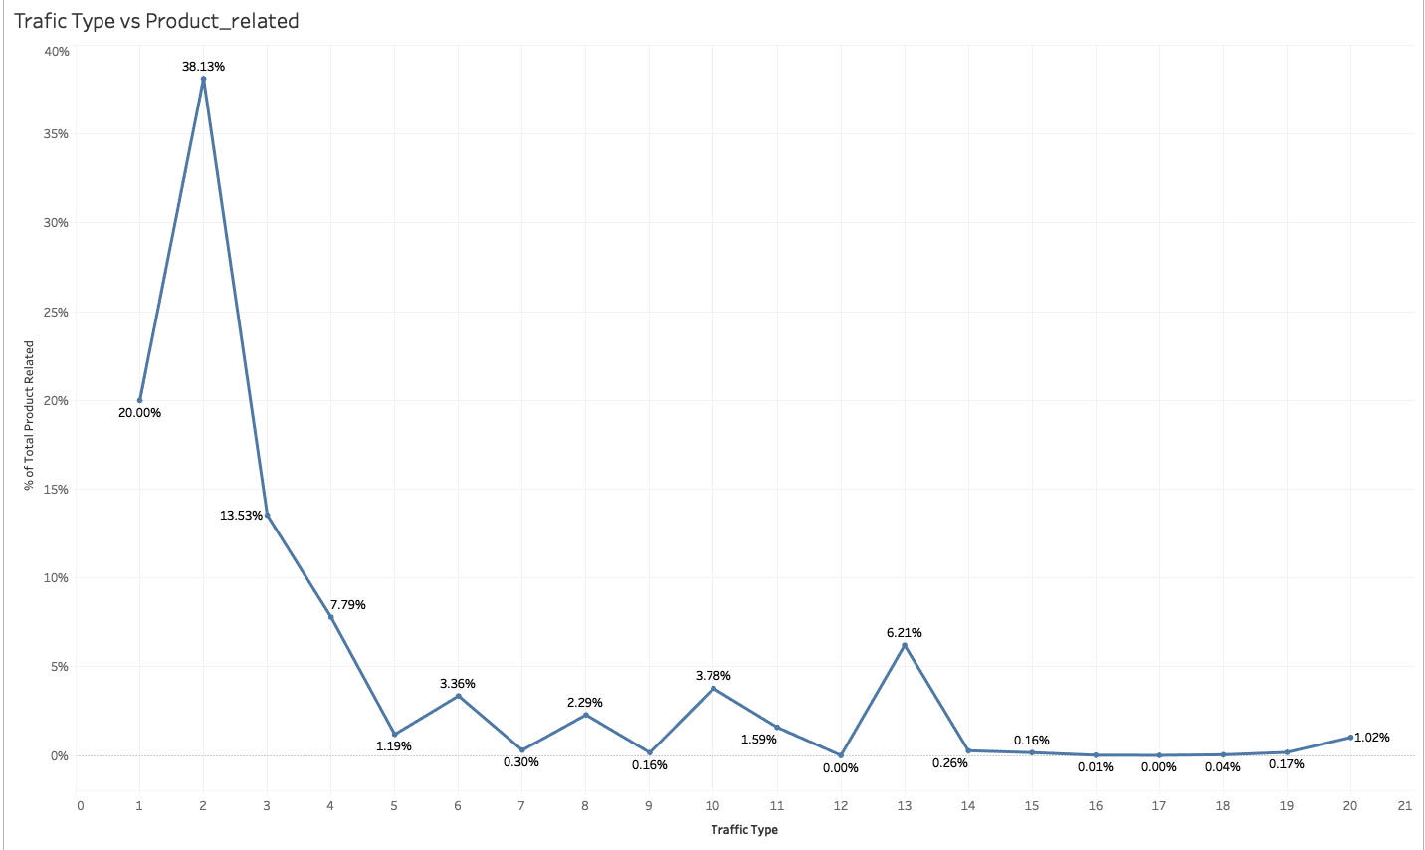
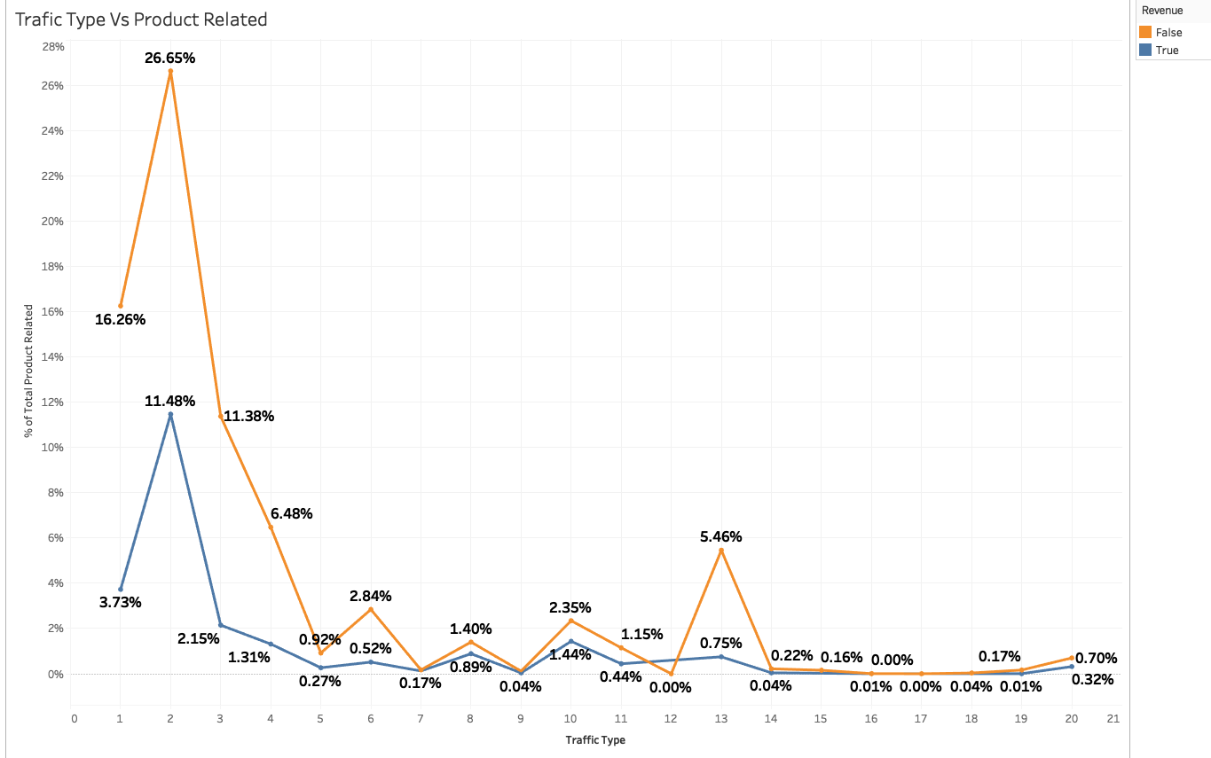
Visits Based analysis:
Visits from the Traffic type :
Max from Traffic Type “2”
Min from Traffic Type “16,17 etc”
From Traffic Type 12,10
Conversion rate is high(No.if visits are low ) But all the visitor are generating Revenue.

Slide 21
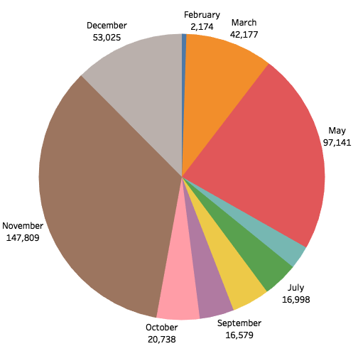
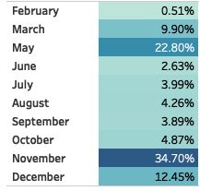
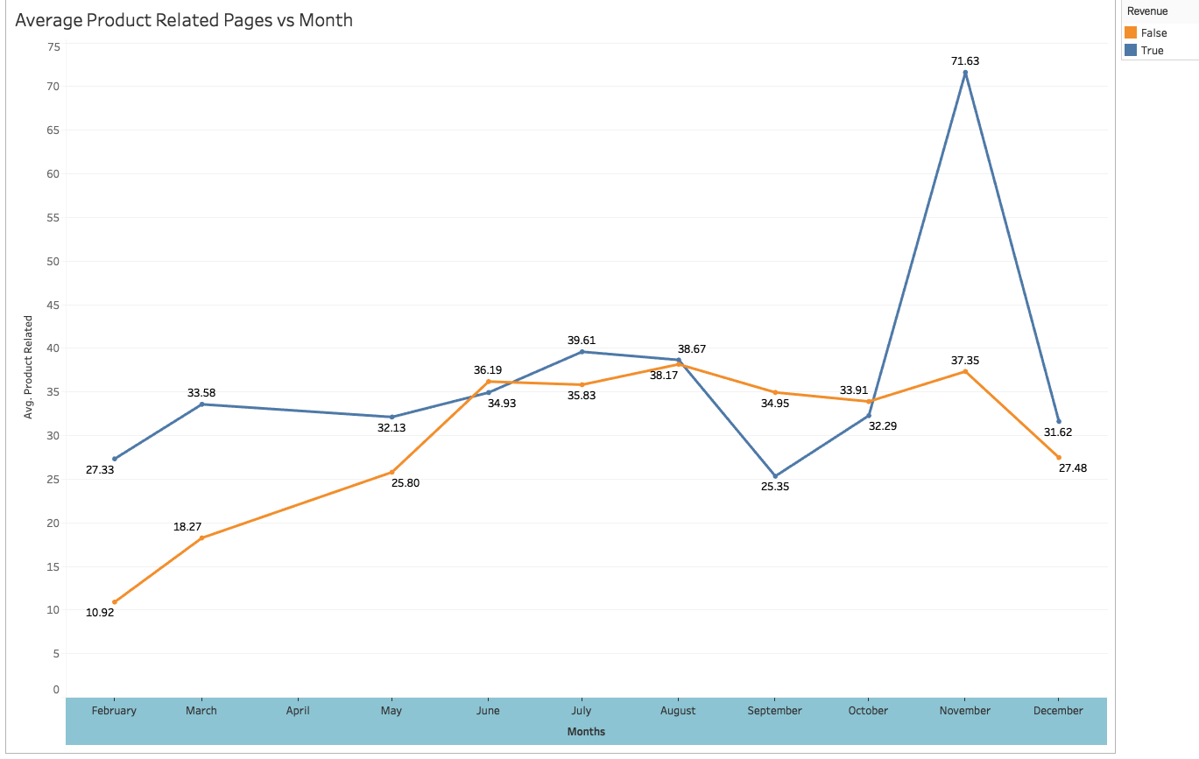
Customer Visits:
Max in November(34.70% of Total)
Min in February(0.51%) of Total
Average Product related pages visited
Revenue Generating visitor are visiting more product related pages.
Averagely it is high in November and low in September.

Slide 22
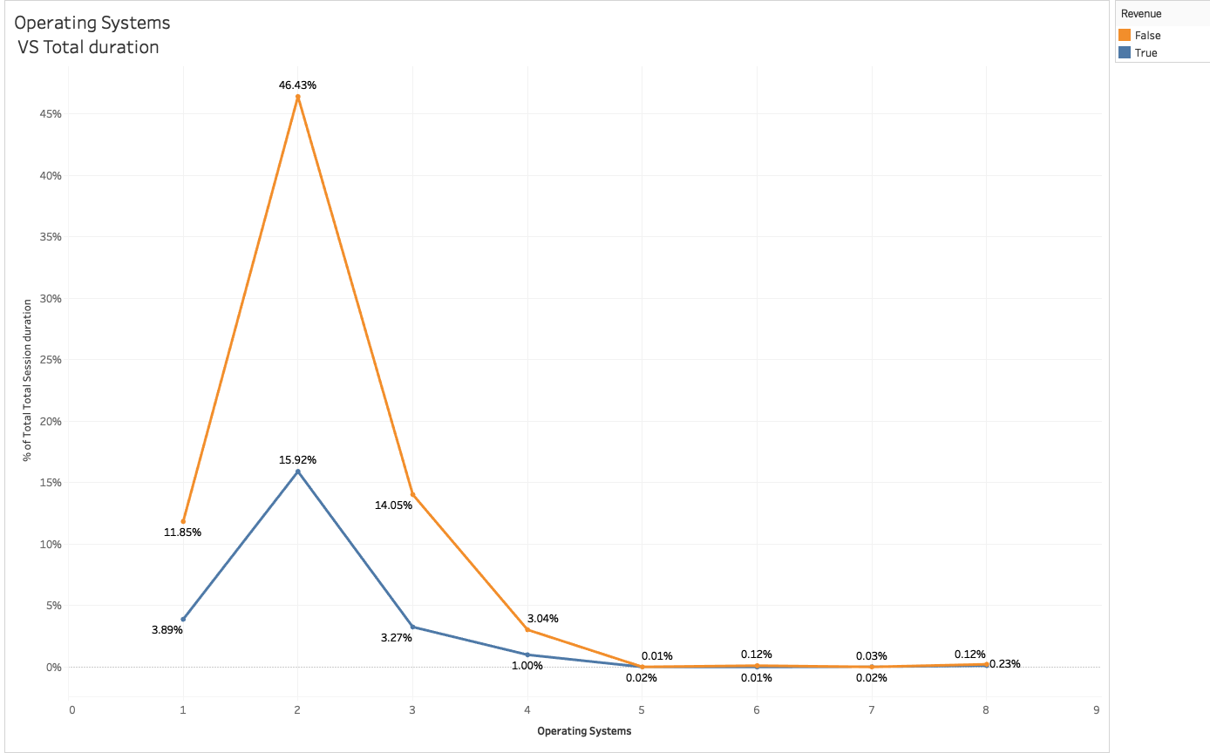
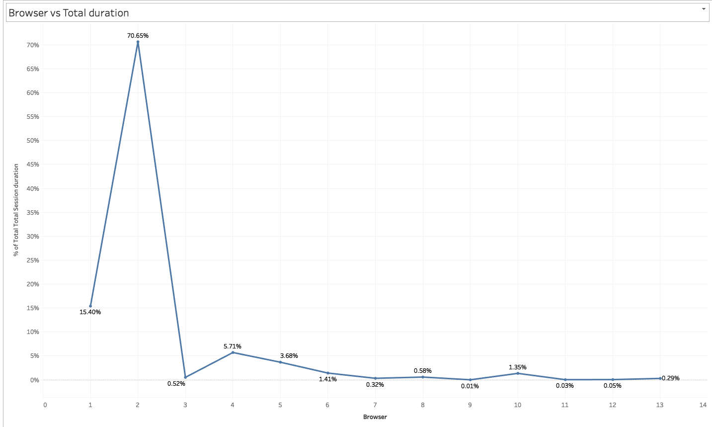
Operating system Type has highest customer visits when compared to other OS.
Browser Type “2” is having highest customer visits

Slide 23
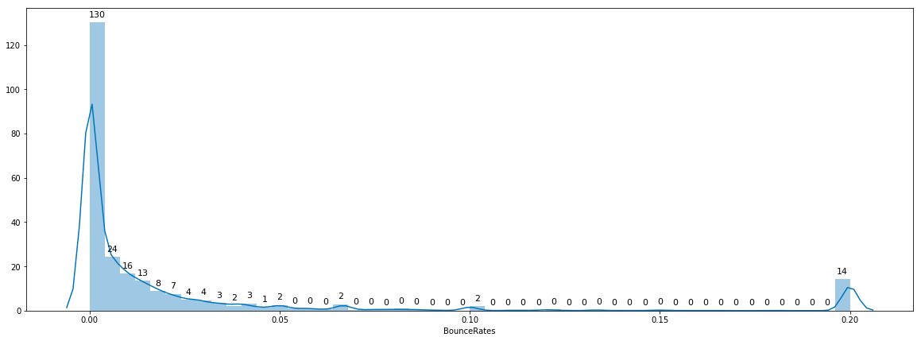
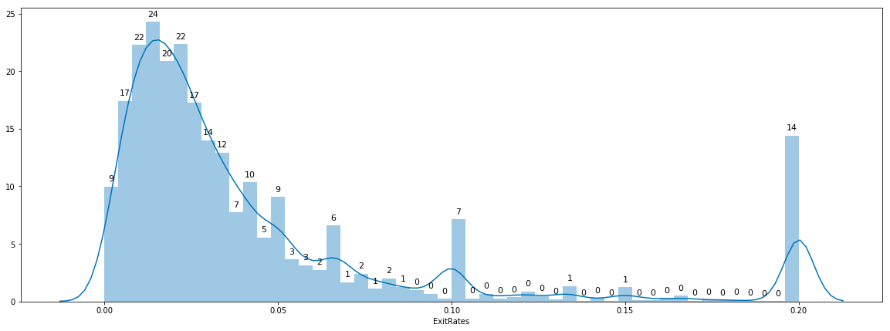
Bounce Rates
Median Of the BounceRates is 0.003 sec
Std Deviation is: 0.048 sec
Median Of the BounceRates is 0.025 sec
Std Deviation is:0.048 sec
Exit Rates

Slide 24

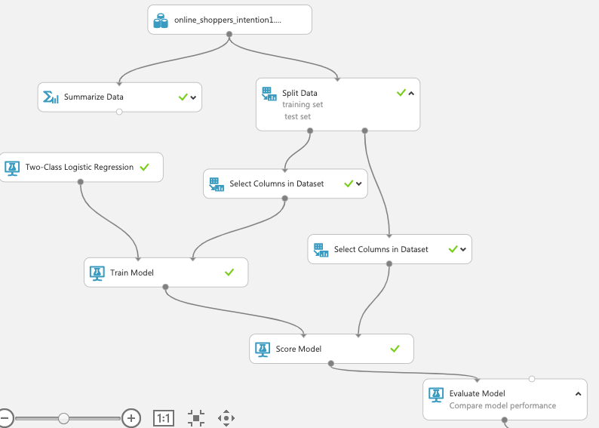
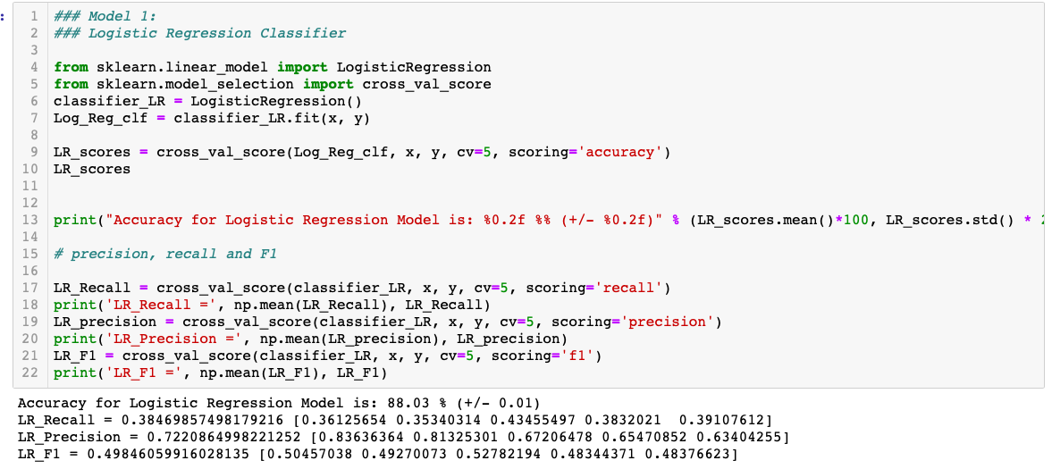
Base Model :
Logistic Regression as the Base model
Flow chart explains the underlying steps in model creations

Slide 25

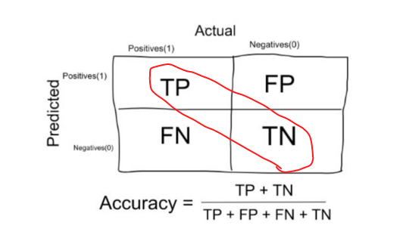
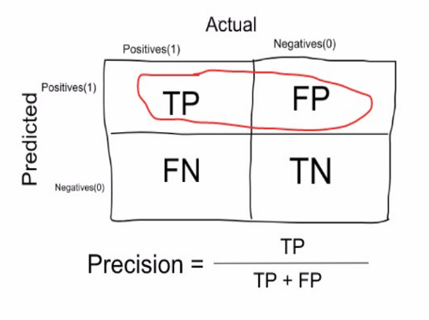
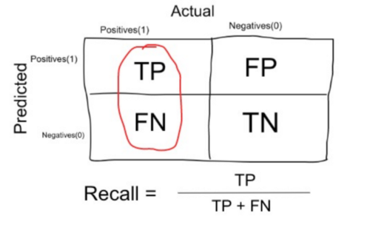
Accuracy: Precision: Recall: F_1Score:
F1 Score =
2 * Precision * Recall / (Precision +Recall)
In the Previous Slide Logistic Regression Evaluation metrics as below:
Accuracy: 88.03%
Precision: 72.2%
Recall: 38.4%
F1_score: 49.8%

Slide 26
Challenges:
Understanding the Domain

Slide 27
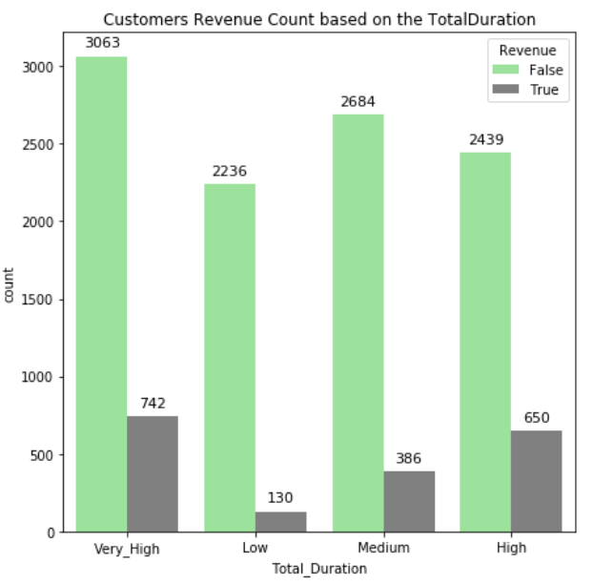
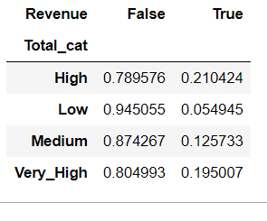

Slide 28
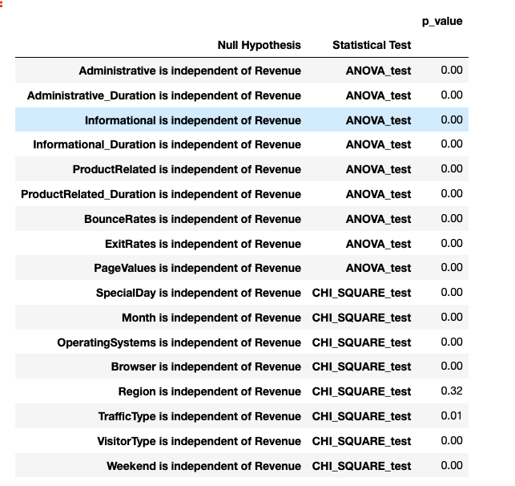
From the Statistical tests we can conclude except Region Variable all the other Variables are Dependent on target variable Revenue.

Slide 29
Further Work:
To Analyse why F1_score is low
Perform :
Feature Engineering
Statistical tests
Reducing the Columns
Model fitting using :
Decision Tree Binary Classifier
Random Forest Classifier
AdaBosting
XGBoost

Slide 30

Personalised experience to be provided to the New Users along with discounts & Cashbacks for first time users to garner interest among New Users.
Partner with websites where traffic type is high (in this case traffic type 2 )such as customized credit cards with reward points, gift vouchers etc so that customer gives Repeat Business. Implement similar strategy with other websites where traffic type can be Increased.
Change the look & feel of website with Minimum Navigations and more relevant content to users which creates interest to the buyer so that exit rates and bounce rates can be minimized.
Plan for Special Day Events on weekends as conversion rates for Special day events are relatively less on weekdays compared to weekends.

Slide 31

Thank you!

Slide 37
Finding and Conclusion
Discussions of Results and Implications:

Slide 38
REFERENCES:

